Slide 1
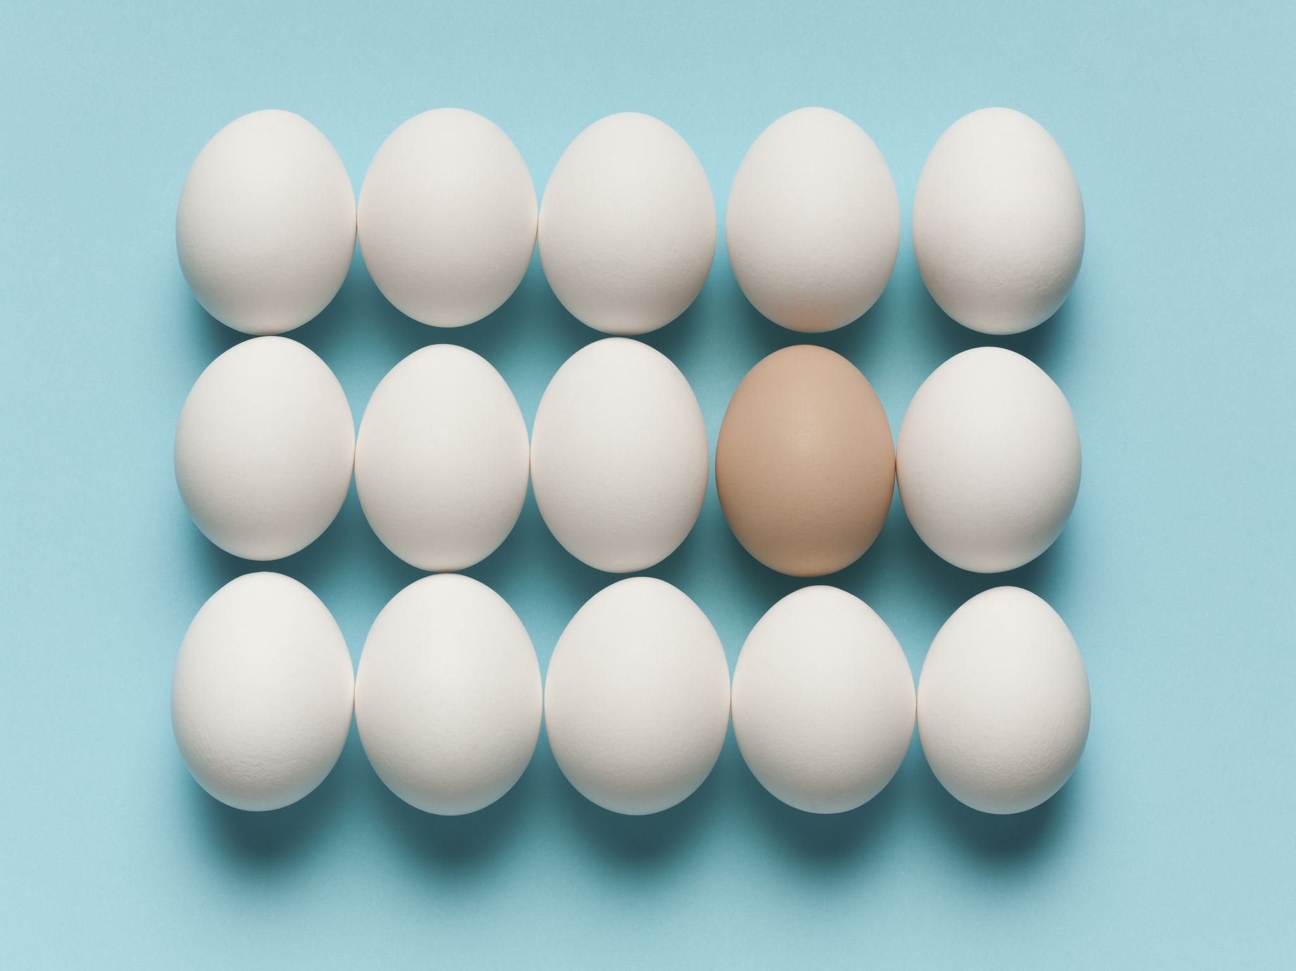
How are eggs used in (influenza) vaccine production?
TED Talk by Anita

Slide 2
Ever been asked about an egg allergy when you were getting a flu shot...
And left wondering why?

Slide 3
What I’ll be Talking About
What eggs have to do with vaccines
A great discovery that occurred 90 years ago
Egg-based vaccine production today

Slide 4
How Vaccines Work
Vaccine: substance administered (to healthy people) as a shot to protect person from diseases
Flu virus reproduces by...
Attaching to host cell
Immune system: protects you from getting sick
Produces antibodies: soldiers to fight viruses
Flu vaccines: contain inactivated (dead) flu virus
When administered, antibodies produced as if live virus
Because you got the vaccine, you are immune!

Slide 5
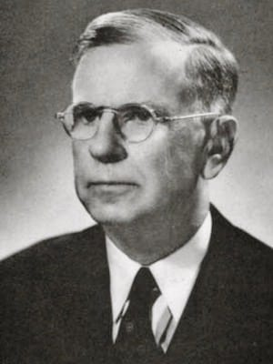
Eggs and vaccines?
Where do we get viruses for vaccines?
Grow viruses
Viruses cannot be cultured like a bacteria or fungi
Ernest William Goodpasture
Invented method to grow viruses in fertilized chicken eggs
Source: https://litfl.com/ernest-william-goodpasture/

Slide 6
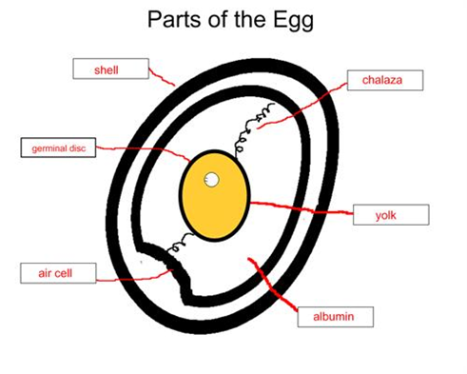
Bird Egg
Self-contained life-support system
Parts of a bird egg:
Germ: only actual part in egg that develops into bird
Shell: for protection
Shell membranes: two skins just inside shell
Air cell: between two membranes
Albumen (egg white): surrounds and protects embryo
Yolk: main source of food for embryo
Chalaza: keeps yolk in middle of egg so it doesn’t break

Slide 7
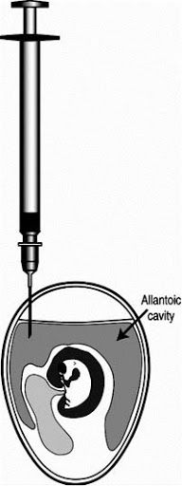
Goodpasture Grows Viruses in 1931
Inject virus into allantoic cavity of a whole fertilized egg
Virus starts replicating in egg
US Military in 1940s used eggs for influenza vaccines
Today: 90% vaccine viruses grown in chicken eggs
Tens of millions of eggs
Eggs readily available, main method

Slide 8
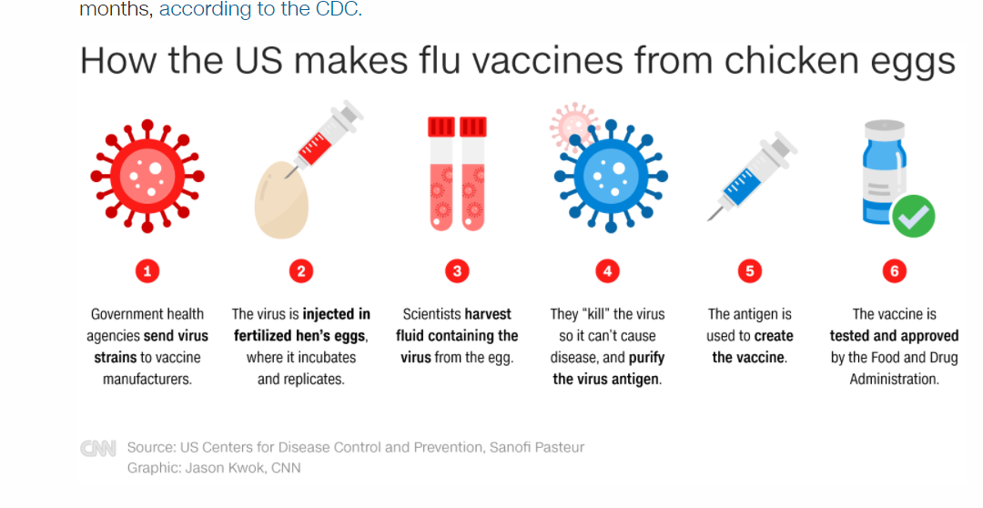
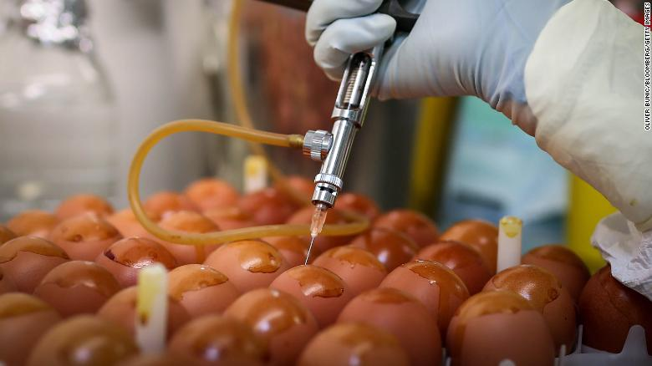
Modern Procedure for Influenza Vaccine Production
Six-month process:
Scientists identify next flu virus strain
WHO sends CVVs to manufacturers
1 vial
Injected into thousands of eggs
Incubated for 2-3 days
Virus separated from egg
Virus inactivated: antigen
Thousands of liters
Diluted
Tested and approved
Testing in animals
Approved by FDA
Source: https://www.cnn.com/2020/03/27/health/chicken-egg-flu-vaccine-intl-hnk-scli/index.html

Slide 9
Why We Should Care About Egg-Based Production
Know how your vaccines are produced
Know where vaccine virus comes from
Importance of eggs
How viruses reproduce

Slide 10
Citations
How Influenza (Flu) Vaccines Are Made | CDC
The Flu Shot and the Egg
Flu Vaccines Grown in Chicken Eggs
How are eggs used to make flu vaccines? – YouTube
What is the role of the chicken egg in making the influenza vaccine? - ABC News
Egg-based Vaccine Production - Creative Biolabs
WHO | Pandemic influenza vaccine manufacturing process and timeline
A chicken's egg (1931) | British Society for Immunology
History and evolution of influenza control through vaccination: from the first monovalent vaccine to universal vaccines
The US keeps millions of chickens in secret farms to make flu vaccines. But their eggs won't work for coronavirus – CNN
How do Viruses Reproduce? - YouTube https://youtu.be/QHHrph7zDLw
Photos

