Slide 1
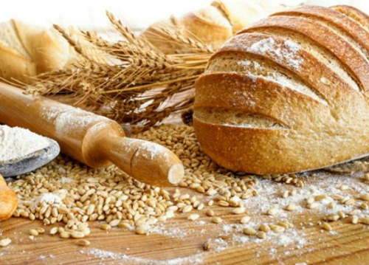
How do different types of yeast change the amount of rise in bread?
Emma Erven-Cook
“Fermentation and civilization are inseparable.”
-John Ciardi
https://www.foodstoragemoms.com/31-tips-making-bread-like-pro/

Slide 2
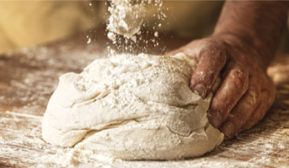
What will I be talking about?
https://www.pmq.com/adding-yeast-to-your-dough-mix/

Slide 3
What is yeast?
Miniscule, unicellular fungi
Multiplies by budding
Grows best in an environment with the following:
Warmth (25ºc-30ºc)
Moisture
Starch and sugar
Saccharomyces cerevisiae
https://www.pinterest.co.uk/pin/127930445646173087/

Slide 4
What is yeast?
https://www.youtube.com/watch?v=iyWtp_L0Kzc

Slide 5
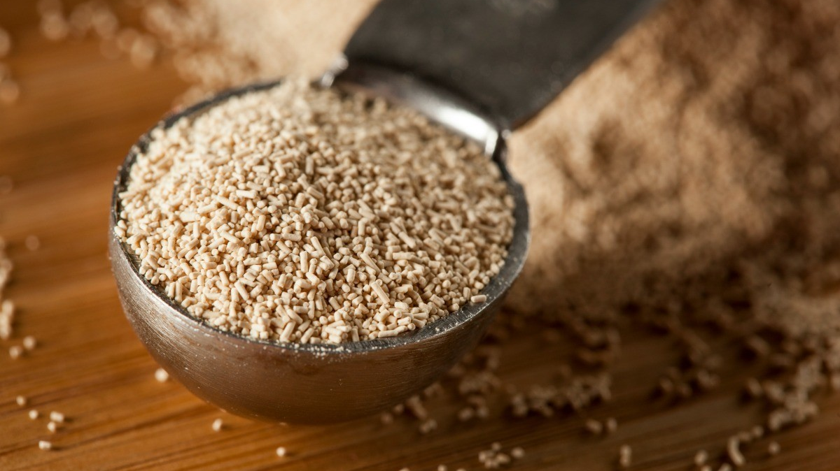
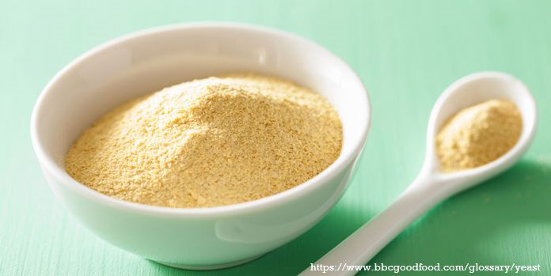
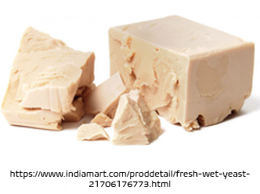
What is yeast?
How do they ‘make’ yeast?
https://www.thriftyfun.com/Storing-Yeast-1.html

Slide 6
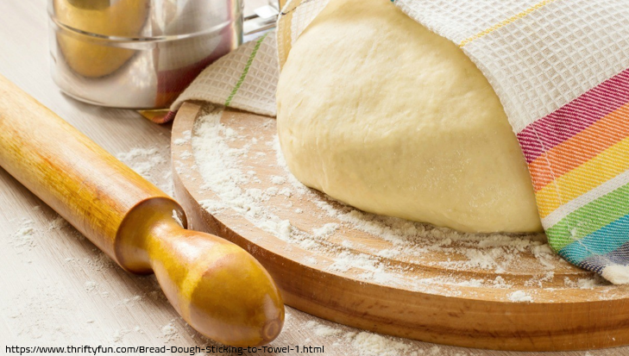
How does yeast work?

Slide 7
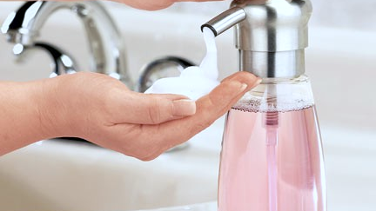
https://automaticsoapdispenser.co/how-to-refill-foaming-soap-dispenser/

Slide 8
how do different types of yeasts differ, and how does this affect the amount of rise in bread?
Types of yeast:
Compressed yeast
Active dry yeast
Instant dry yeast
Cream yeast

Slide 9
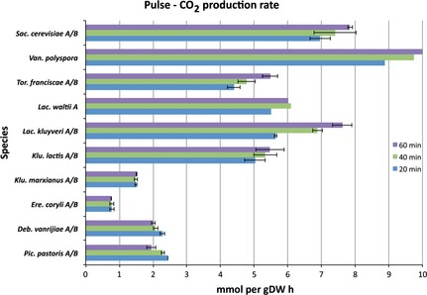
how do different types of yeasts differ, and how does this affect the amount of rise in bread?
https://www.researchgate.net/figure/Carbon-dioxide-production-rates-for-various-yeast-species-Carbon-dioxide-is-produced_fig4_265092997

Slide 10
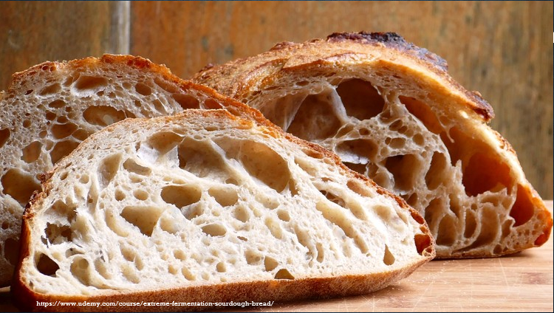
“You can’t just leave out one part; the bread won’t rise if the yeast isn’t there”
-Holly Near

Slide 11
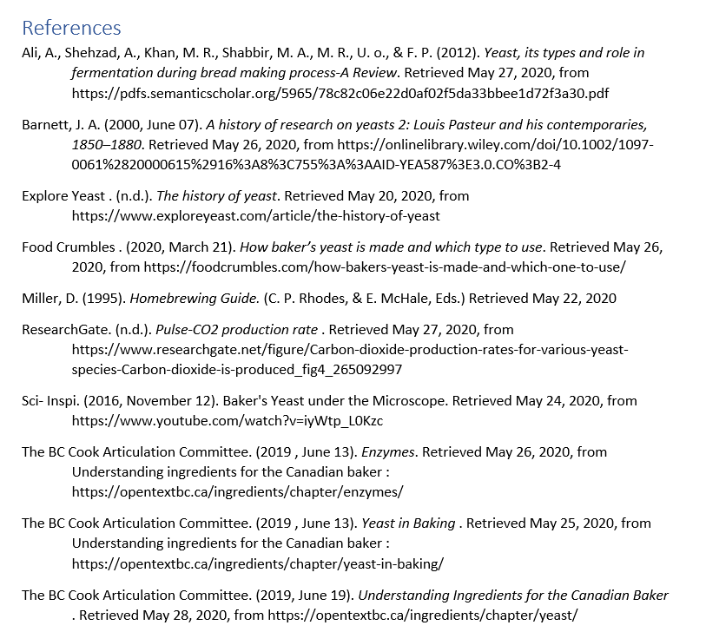
References
https://www.foodstoragemoms.com/31-tips-making-bread-like-pro/

