Slide 1
How does sound affect plant growth
By: Hailey Stewart
Notes:
What if the sound in your house could be affecting the growth of your plants? My name is Hailey Stewart and welcome to my Talon talk

Slide 2
Can Plants Hear?

Slide 3
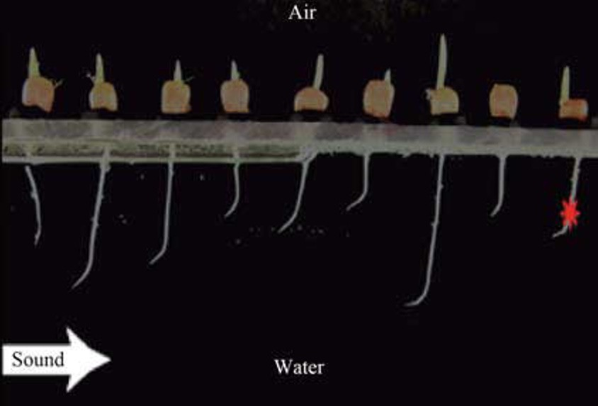
Plants can hear sound?
Notes:
like stated in the video and shown in this diagram plants grow towards sound. In the universities case the peas grow towards the sound of water and in this study done with a group of zea mays the seedlings clearly bend towards the sound source coming from the white arrow. This indicates that plants can hear sound and use it as a way of establishing where their roots need to form in order to reach a water source

Slide 4
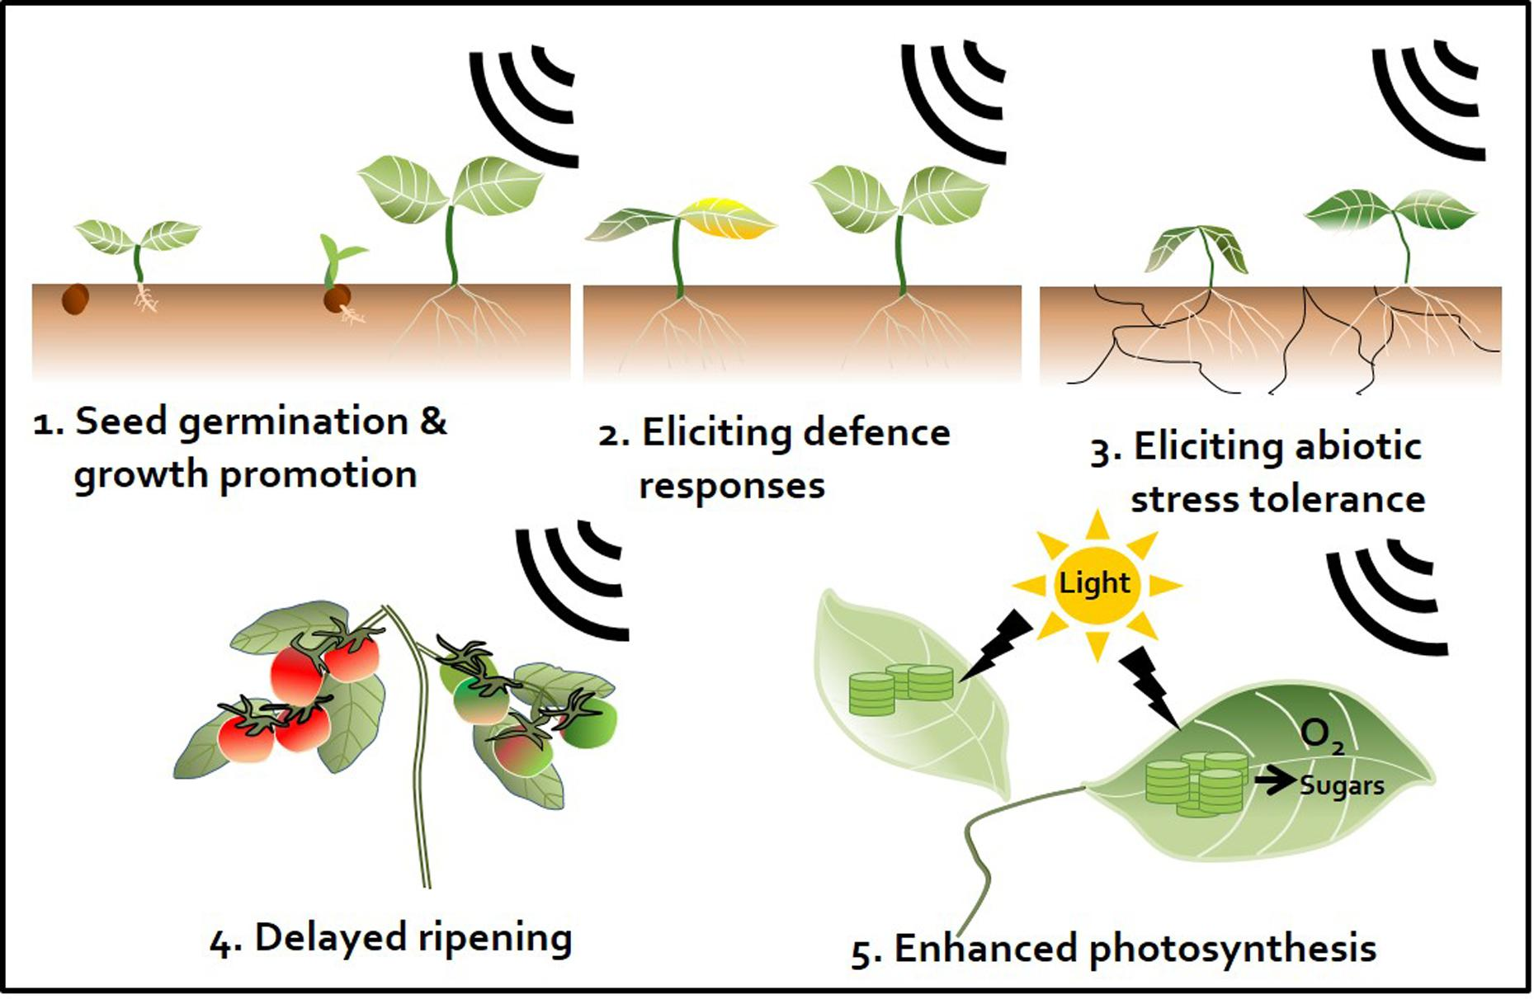
Sound Changes how the plant works
PAFT (plant acoustic frequency technology) improves cell division
Increases stress tolerance
Delays ripening
Increases the production of beneficial hormones and enzymes
Increases the production of sugars and proteins
Speeds up photosynthesis
Notes:
Not only does sound effect where the plant roots travel it also effects many other characteristics of the plant. Plant acoustic frequency technology of PAFT is proven to improve cell division, increase stress tolerance during drought, delays ripening of product, increase the production of beneficial hormones and enzymes, increase the production of sugars and proteins and speeds up photosynthesis. Improved cell division and increased photosynthesis can speed up the growth of plants and the delayed ripening of some products both of which could be very useful in the food industry as it speeds up the production of food at delayed ripening could eliminate the need for some GMOs

Slide 5
Sounds improves plants immune systems
PAFT boosts the immune system of plants
Tomatoes using PAFT decreased diseases such as spider mites, aphids, gray mold, late blight and virus disease by 6%, 8%, 9%, 11% and 8%
Sheath blight of rice using PAFT was reduced by 50%
Notes:
PAFT is also proven to boost the immune symstem of plants. Tomatoes that used PAFT decreased in diseases such as spider mites, aphids, gray mold, late blight and virus disease by 6%,8%,11% and 8% respectively. Spider mites and aphids both infect the plant by peircing leaves and sucking sap to feed themselves and can kill plants. Gray mold and late blight, another kind of mold, both weaken the plant and reduce the output of vegetation. The reduction of these infections also contribute to healthier plants that produce more product. Sheath blight of rice using PAFT was reduced by 50%. Sheath blight can decrease a yeild by up to 50% so the prevention of this virus would also majorly boost a yeild making more food available for consuption or sale.

Slide 6
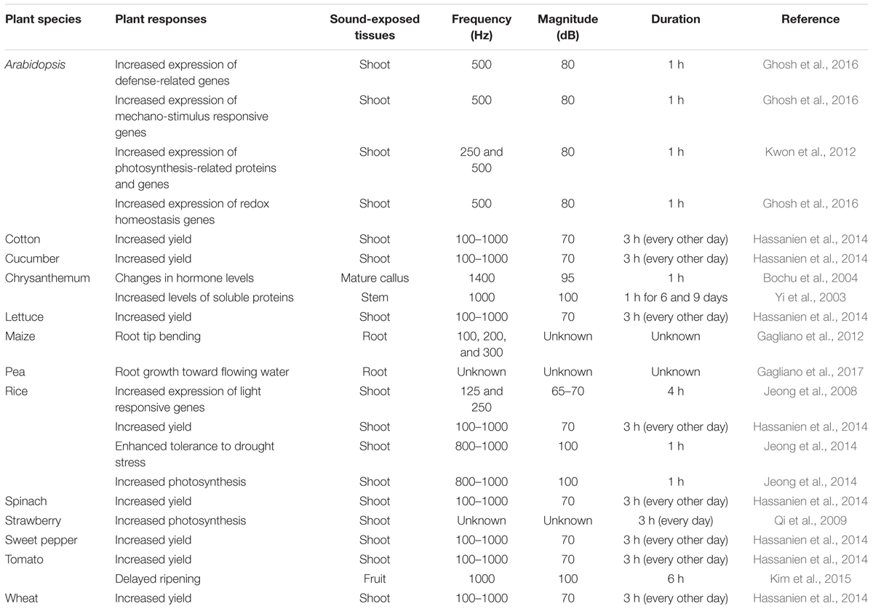
Sound effects on different plants
Sound increased the yield of wheat, tomatoes, sweet pepper, spinach, rice, lettuce, cucumber and cotton
Other improvements such as increased photosynthesis, delayed ripening, changes in genes and hormones and tolerance to stress occurred in different plants
Notes:
Pictured on the slide is a chart of different tests done with sound on different plants. They were all exposed to specific frequencies of sound played for different exposure periods. Certain plants do best with certain tones while some tones could do damage to a plant so experiments used tones that best fit each plant species. The implementation of these sounds increased the yields of wheat, tomatoes, sweet peppers, spinach, rice, lettuce, cucumber and cotton. These sound tests also included other improvements on certain plants such as increased photosynthesis, delayed ripening, changes in genes and hormones and tolerance to stress.

Slide 7
Sound improves plant yields
Using PAFT every other day on sweet peppers, cucumbers and tomatoes increased the yield by 30.05%, 37.1% and 13.2%
Using PAFT the yield of lettuce, spinach, cotton, rice and wheat increased by 19.6%, 22.7%, 11.4%, 5.7% and 17%
Notes:
The biggest benefit of PAFT is the increase in yield. A yield is the amount of product produced by a plant like fruits or vegetables. An experiment was done using PAFT exposing sweet peppers, cucumbers and tomatoes every other day to 0.1-1kHz for 3 hours and this increased their yeilds by 30%, 37.1% and 13.2%. The same experiment was done on lettuce, spinach, cotton, rice and wheat as well and their yeilds increased by 19.6%, 22.7%, 11.4%, 5.7% and 17%. Just by exposing these different plants to sound they increased production by up to almost 40%.

Slide 8
Why should you care?
It naturally increases a plants yield and delays ripening without using GMOs
It naturally prevents disease without using pesticides
It makes plants resistant to certain stresses making it healthier
It makes plants grow faster
It majorly increases the amount of food production with up to 40% increase
Notes:
Why should you care. Sound therapy provides a natural way to increase a yield and delay ripening without having to use GMOs which would make it doable at home. Sound therapy naturally prevents pests and diseases without having to use pesticides. It can make plants more tolerant to some stress. It speeds up the growth process. And the biggest benefit is it incresases the ammount of food produced with an up to 40% increase.

Slide 9
Sources
Works Cited
1. Adam Sparks, N. C. (2020, January 1). Sheath Blight. Retrieved June 2020, from Rice Knowledge Bank:
http://www.knowledgebank.irri.org/training/fact-sheets/pest-management/diseases/item/sheath-blight
2. Anna Johnson, M. G. (2016, January 1). Late blight of tomato and potato. Retrieved June 2020, from University of Minnesota Extenstion:
https://extension.umn.edu/diseases/late-blight
3. Jihye Jung, S.-K. K.-J.-M. (2018, January 30). Beyond Chemical Triggers: Evidence for Sound-Evoked Physiological Reactions in Plants. Retrieved June 2020,
from frontiers in Plant Science: https://www.frontiersin.org/articles/10.3389/fpls.2018.00025/full
4. Planet Natural Research Center. (2020, January 1). Aphid. Retrieved June 2020, from Planet Natural Research Center:
https://www.planetnatural.com/pest-problem-solver/lawn-pests/aphid-control/
5. Planet Natural Research Center. (2020, January 1). Gray Mold. Retrieved June 2020, from Planet Natural Research Center:
https://www.planetnatural.com/pest-problem-solver/plant-disease/gray-mold/
6. Reda H E Hassanien, H. T.-z. (2014, February 13). Journal of Integrated Culture. Retrieved June 2020, from ScienceDirect:
https://www.sciencedirect.com/science/article/pii/S209531191360492X/pdf?md5=aeccf54158313362bb745173f416b5a2&pid=1-s2.0-S209531191360492X-main.pdf

