Slide 1
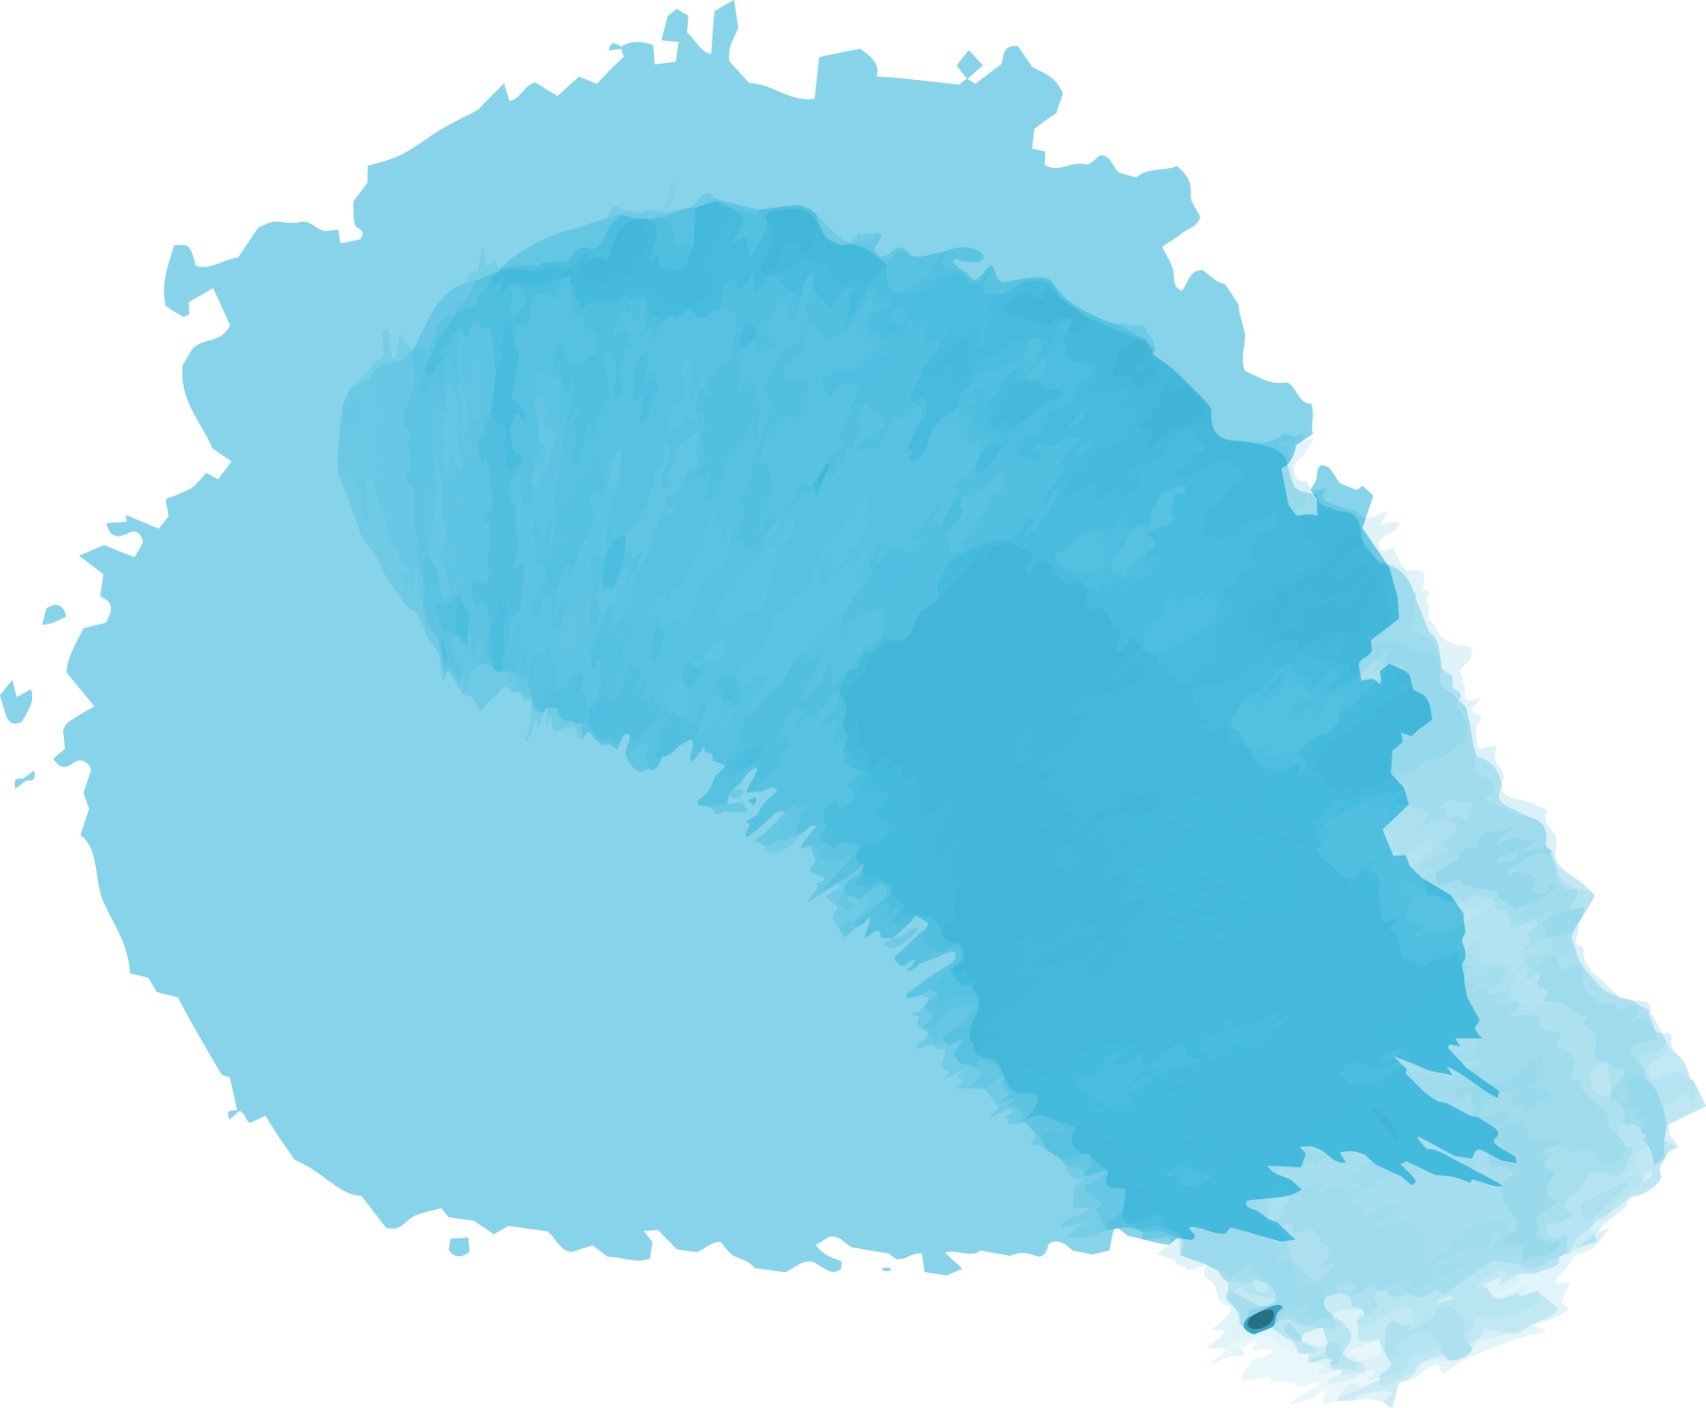
Quilting!
Hailey’s 2021 in-depth project

Slide 2
Contents
Meet the mentor
Choosing a final product
What is quilting
Why did I choose quilting
Action plan
Stage one
Stage two
Stage three
Stage four
The reveal
Summary

Slide 3
What is quilting?
According to Wikipedia: Quilting is the term given to the process of joining a minimum of three layers of fabric together either through stitching manually by hand using a needle and thread, or mechanically with a sewing machine or specialised longarm quilting system.
If you have no clue what any of that meant I will break down the steps in the following slides but here are some key terms to know:
Pattern: set of instructions Backing: material on the backside of a quilt
Block: one section of quilt Seam: where material has been sewn together
Fat quarter: 5x5 piece of material Unpicking: ripping out threads to undo sewing
Top layer: patterned side of quilt Basting: temporarily sewing material together
Batting: quilt ’stuffing’

Slide 4
Why did I choose quilting?
Experience
History
Interest
I have been sewing for years doing a variety of different styles including machine and hand sewing
I have always wanted to try quilting but I never had time
Mentor
Quilting has been passed down for generations on my mom’s side
It was very easy to find a mentor

Slide 5
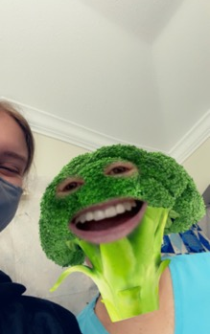
Meet the mentor
Who is the first person you think of when you think sewing? If it’s someone's grandma, you know exactly where the expertise in the quilting world comes from. Over the years I have been taken to many sewing shows by my nana and 99% of the attendees apply for the seniors discount. So who was the perfect senior to ask? My nana of course. After quilting for over 20 years she knows her stuff. She was also the lady who taught me how to hand and machine sew so it only made sense she was the first person to ask
(The master herself)

Slide 6
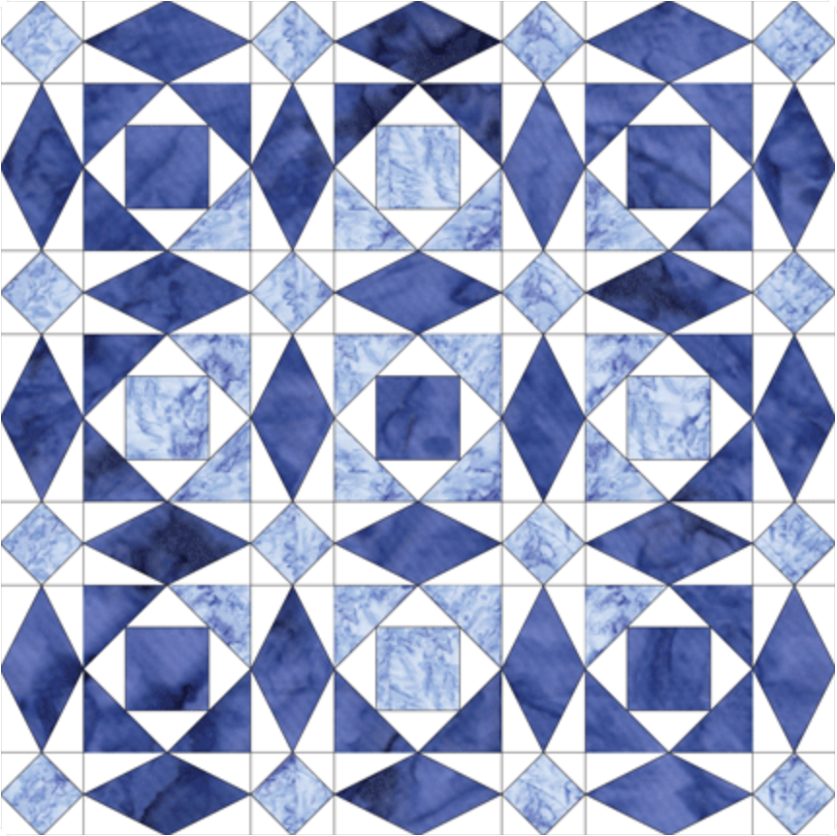
Choosing a final product
After I had chosen what my topic was going to be and who my mentor was going to be I had to choose what I was working for. My mentor and I decided that given the timeframe a wall hanging piece would be the best use of time.
After we had the size decided we needed to pick a pattern. Did I decide to start with an easy pattern for my first quilt? No. Why would I do that? We ended up choosing the storm at sea pattern. This pattern utilized a method called paper piecing where the quilter sews the materials together on a piece of paper and uses the lines printed on the paper as a guide on where to sew.
The conclusion we came to was that my final project was going to be and 8x8 block wall hanging quilt with a blue themed colour pallet to compliment the name and it was going to be a storm at sea pattern.
(Storm at sea 3x3 digital pattern)

Slide 7
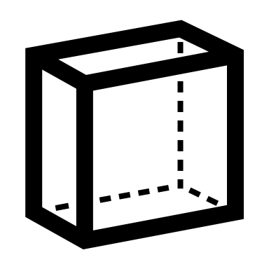
Action Plan
After I had figured out what I wanted to do, I needed to figure out how to get there. My quilting process can be broken down into 4 steps.
Sewing small
Sewing together
This included pinning and sewing the pieces in each block together plus trimming and ironing in between
Cutting
Quilting
This included pinning and sewing each block piece together in long strip then sewing the long strips together to create the top layer
This included cutting out every individual piece of fabric needed for the piece. In total the quilt has 575 pieces.
This included quilting the three layers of quilt (top layer, batting, backing) together in lines that holds the quilt together (plus adding the pole slip at the back)

Slide 8
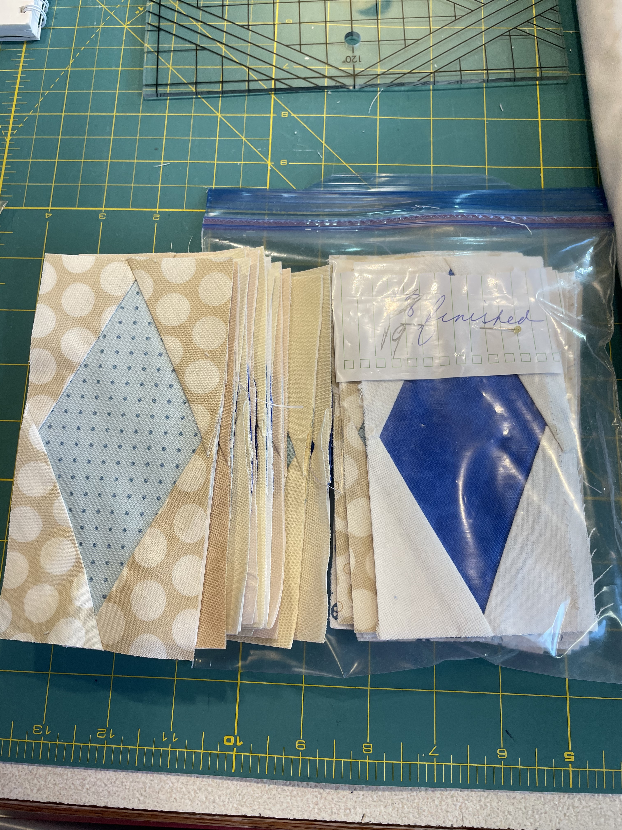
Stage one: cutting
This stage didn’t happen all at once since I would cut some pieces then sew then cut some more etc. but it did take up a majority of my time at the beginning of this project. Cutting was very time consuming and probably my least favourite stage since it got very repetitive. In total I cut out 575 pieces that made it in the quilt but due to a miscalculation I ended up cutting over 100 extra diamonds. After the over cutting incident we began to keep everything in neat piles that had labels describing what each bag held (pictured to the right). Not only did I have to cut out the fabric pieces, but I also had to cut the paper pieces that went on the backs of each block piece.

Slide 9
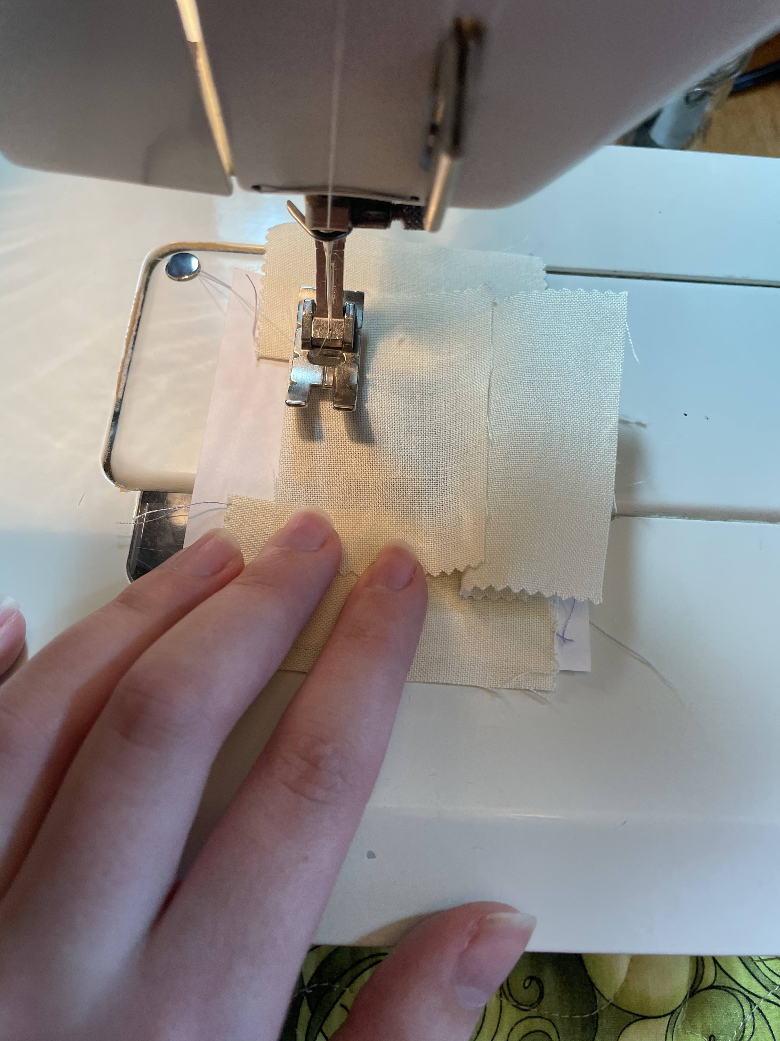
Stage two: sewing small
This stage was the most time consuming of the four stages. This not only included sewing the one or two layers on each block piece but included pinning, ironing in between sewing, cutting fabric down to shape, and a good amount of seam ripping. Thankfully everything in this stage was machine sewn so I could move through a stack of pieces at a good pace. Once a piece was sewn on two sides, it would be ironed flat, trimmed down, had the other two sides sewn, ironed, and cut then repeat for the next layer.

Slide 10
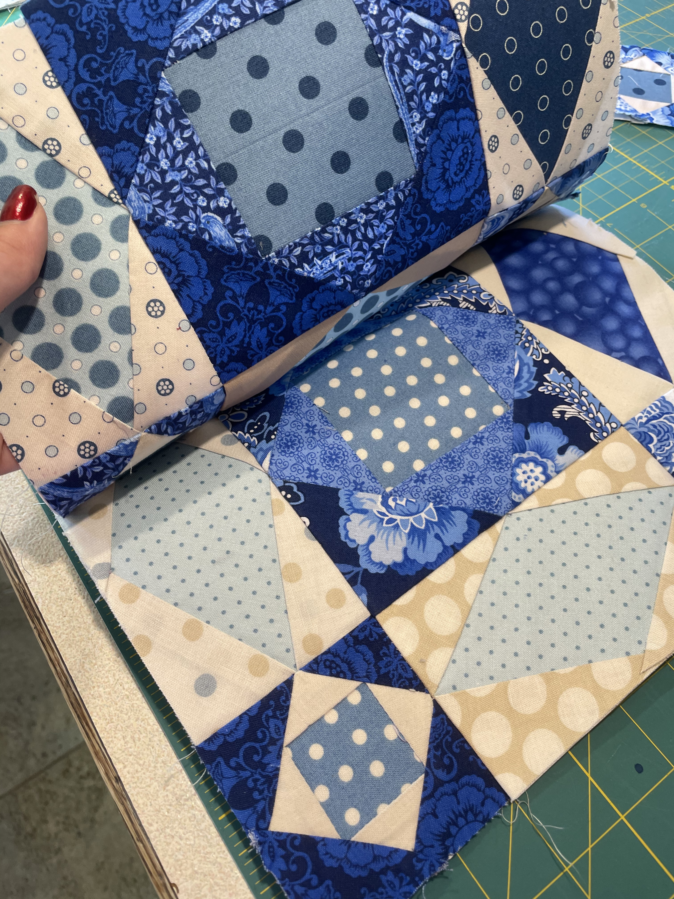
Stage three: sewing together
This stage moved relatively quickly. After trying two different techniques I decided that sewing every block piece together in a vertical strip, then sewing the vertical strips together was the most efficient way to sew the top layer together. By using this method I had fewer long seams which was the most difficult part of this stage. When sewing a long seam it takes a lot of pinning down to ensure that the fabric doesn’t shift and get sewn wonky and its very annoying to unpick if one corner or point doesn’t match up. Once I had finished this stage, the entire top layer which was the hard part was completed.

Slide 11
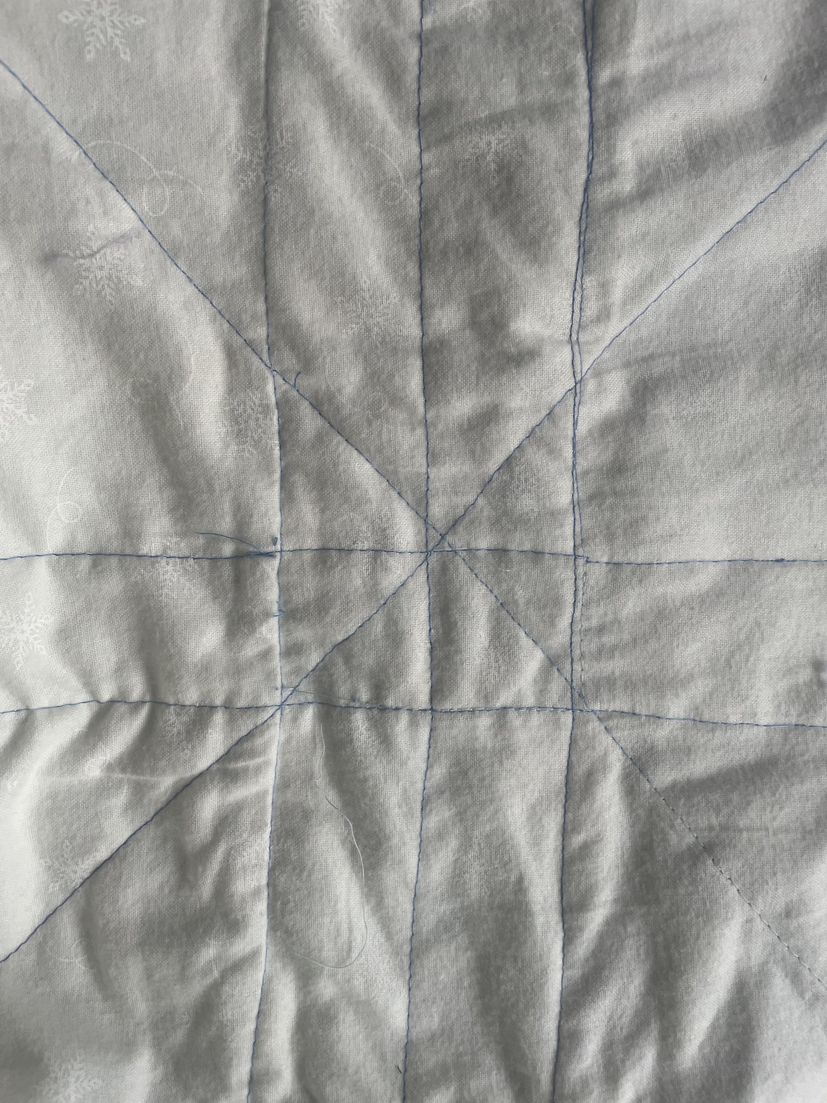
Stage four: quilting
This stage was tying up all the loose ends of the quilt (or hiding them) by creating the three layers of the quilt. We decided on a dark blue border with a white backing and a muslin (a type of material) batting. Instead of doing fancy quilting on the top layer we decided that would take away from the already intricate pattern so we decided to quilt “in the ditch”. No my nana didn’t force me to sew in a hole, it just means quilting on the straight lines and across the quilt instead of the swirlies. Once quilting was done I added a pole pocket across the top so it can be hung on a wall. After trimming some threads and adding some final touches I was finished!

Slide 12
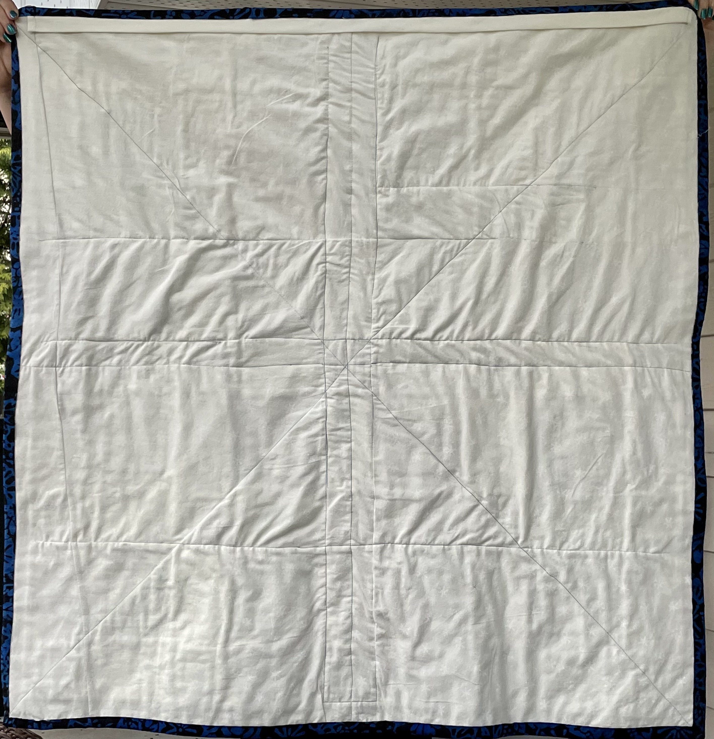
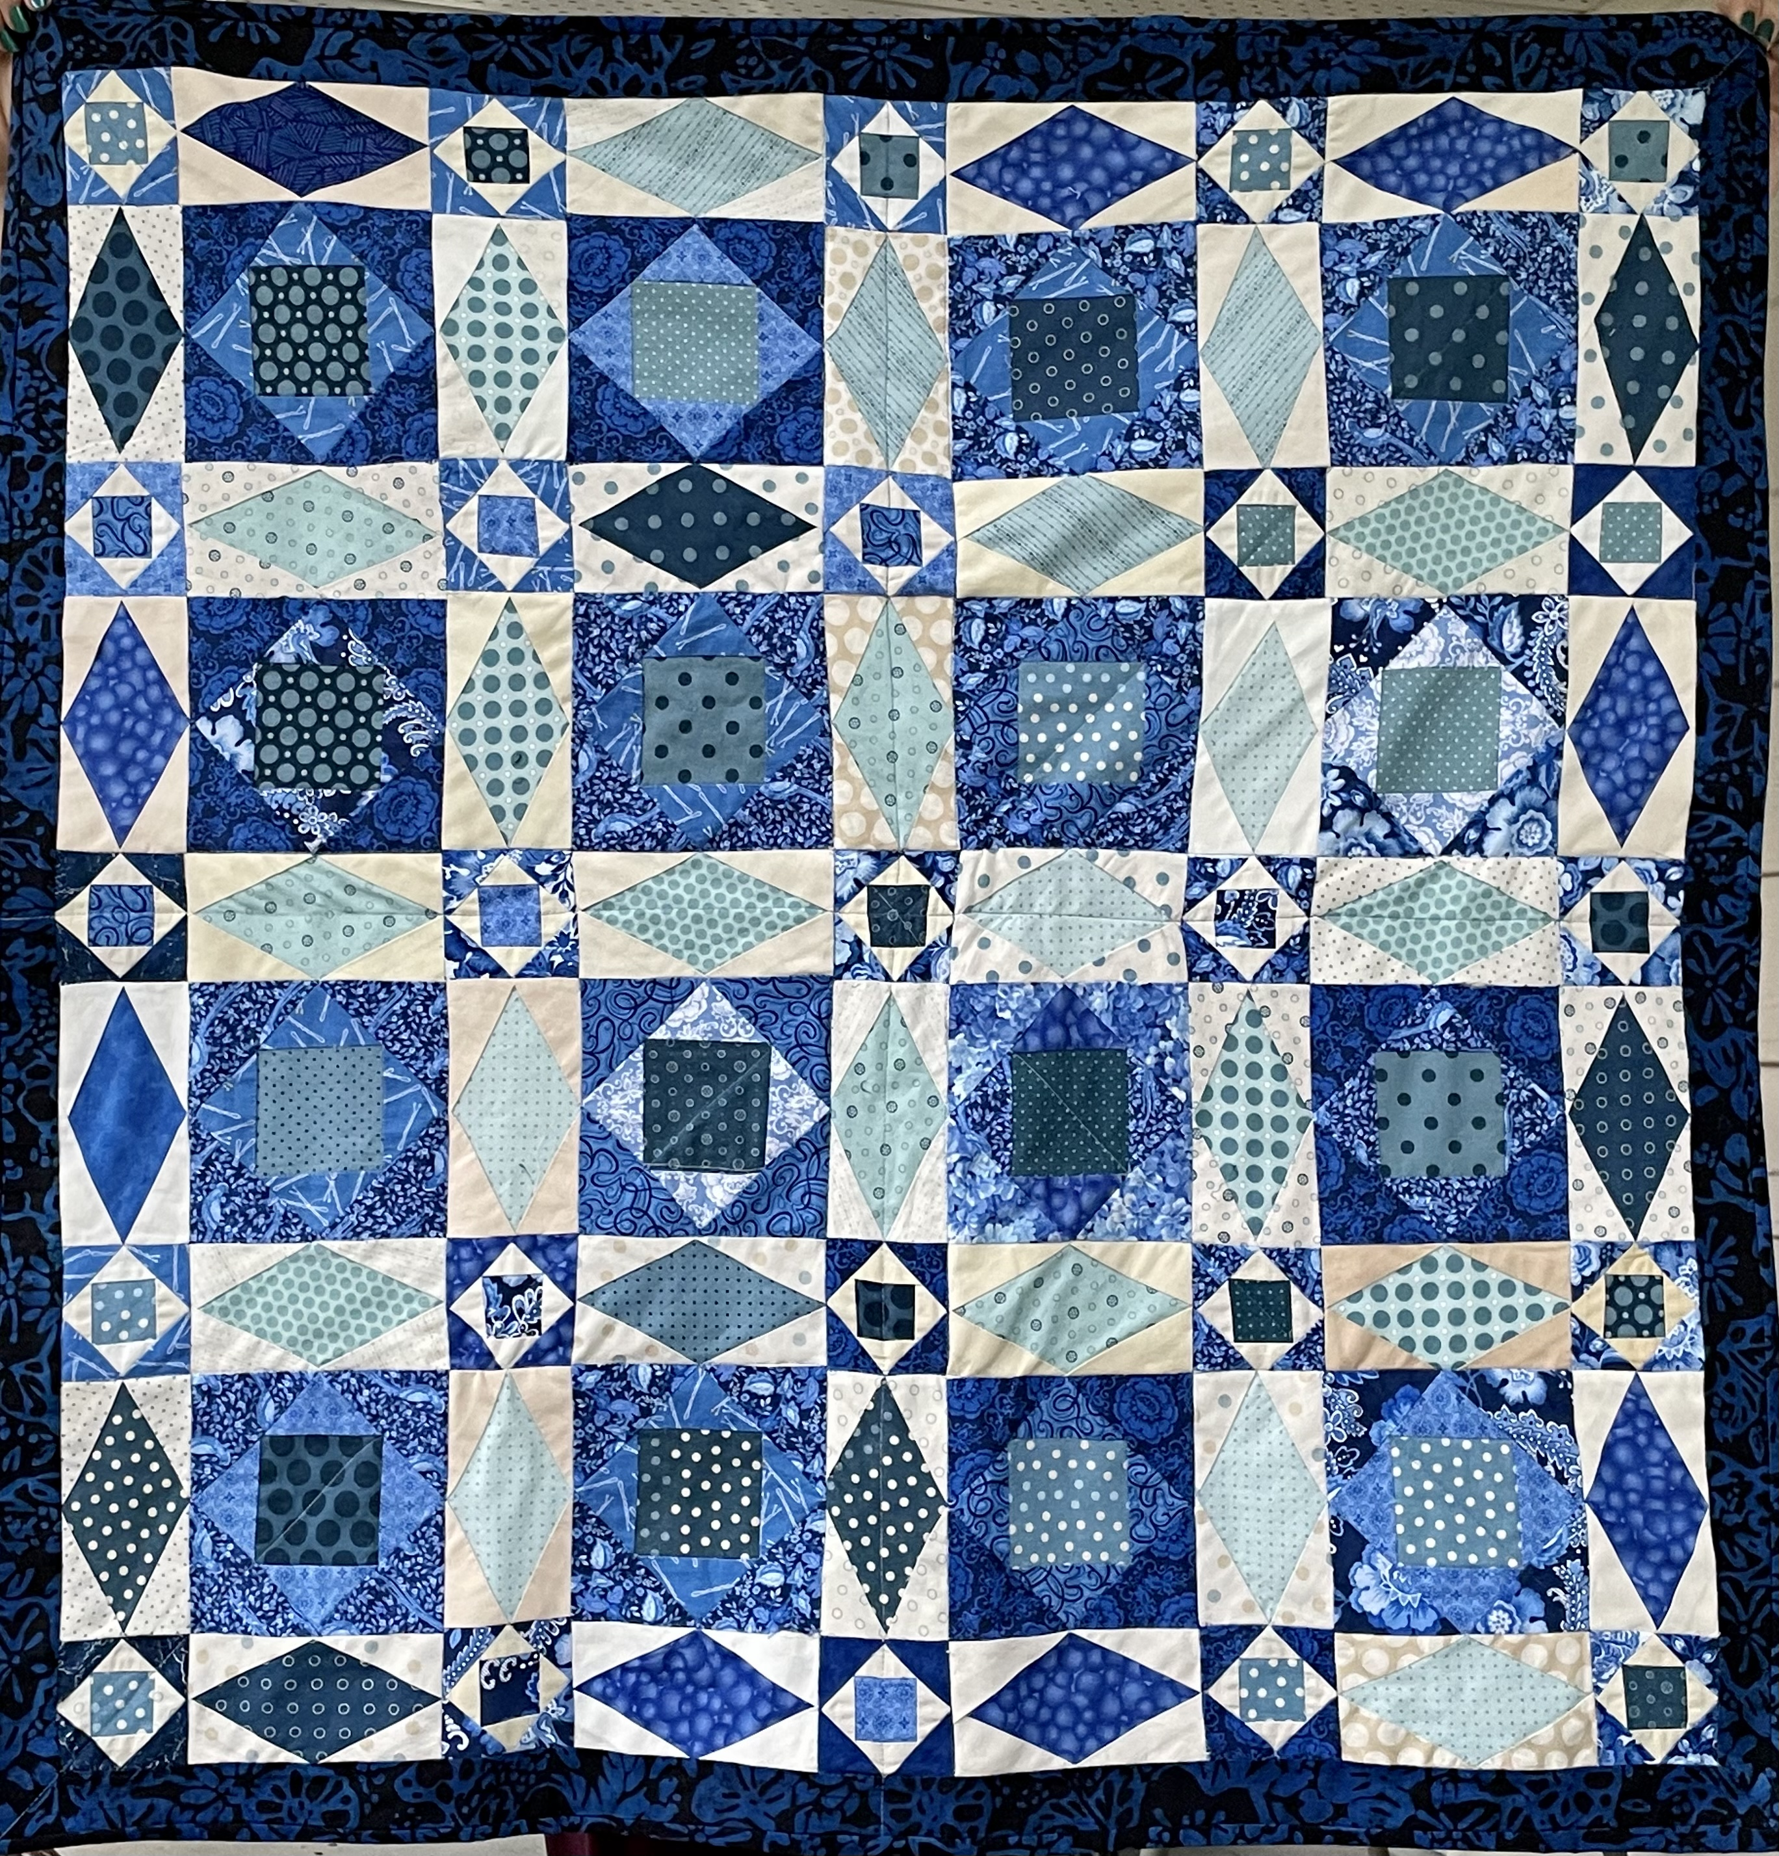
The big reveal

Slide 13
Summary
Overall I had a really good time making this quilt and spending time with my nana. I am really proud of my work and I think I will continue to do this when I can. I hope you enjoyed the presentation and enjoy the rest of in-depth 2021!

