Slide 1
How do the different wavelengths of visible light affect the growth of mold?
By Indah Del Bianco

Slide 2
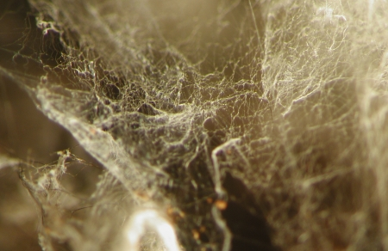
What is mold?
hyphae

Slide 3
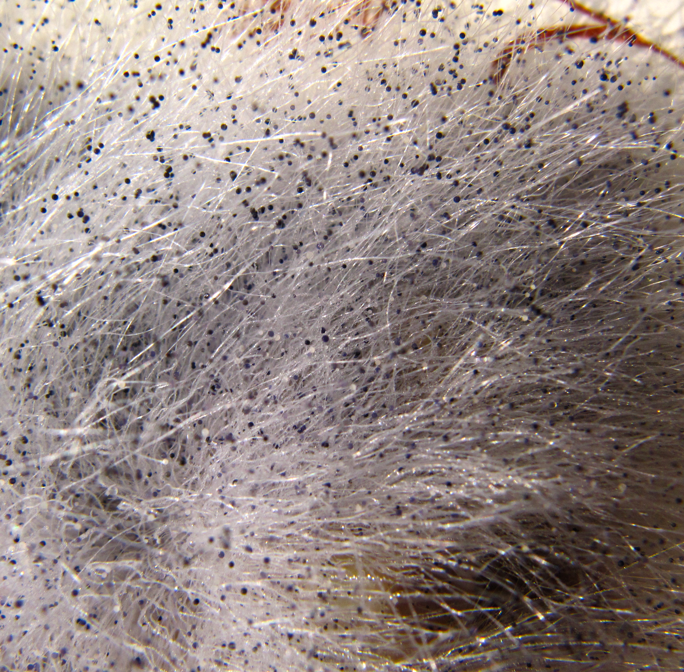
Black bread mold

Slide 4
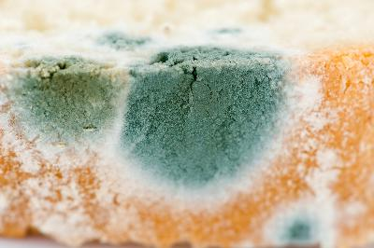
Penicillium Bread Mold

Slide 5
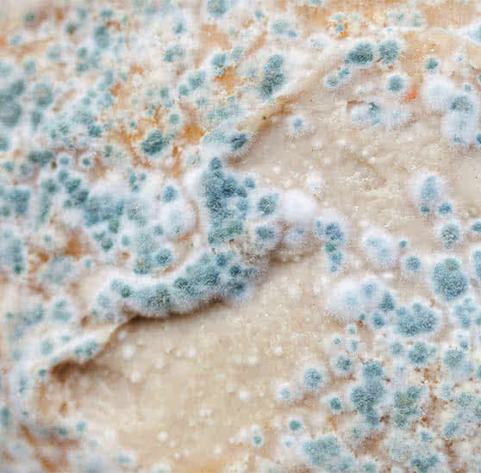
Cladosporium Bread Mold

Slide 6
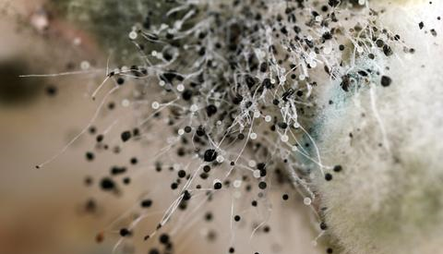
spores

Slide 7
How does mold get energy?
DO NOT use photosynthesis to receive energy > they rely on organic matter to provide energy.
Conditions are usually more favourable in dark areas, BUT mold grows in both the light and dark
Grows best in warm, humid environment
Best between 77 degrees F and 86 degrees F
Require water to grow and spread, need oxygen to survive.

Slide 8
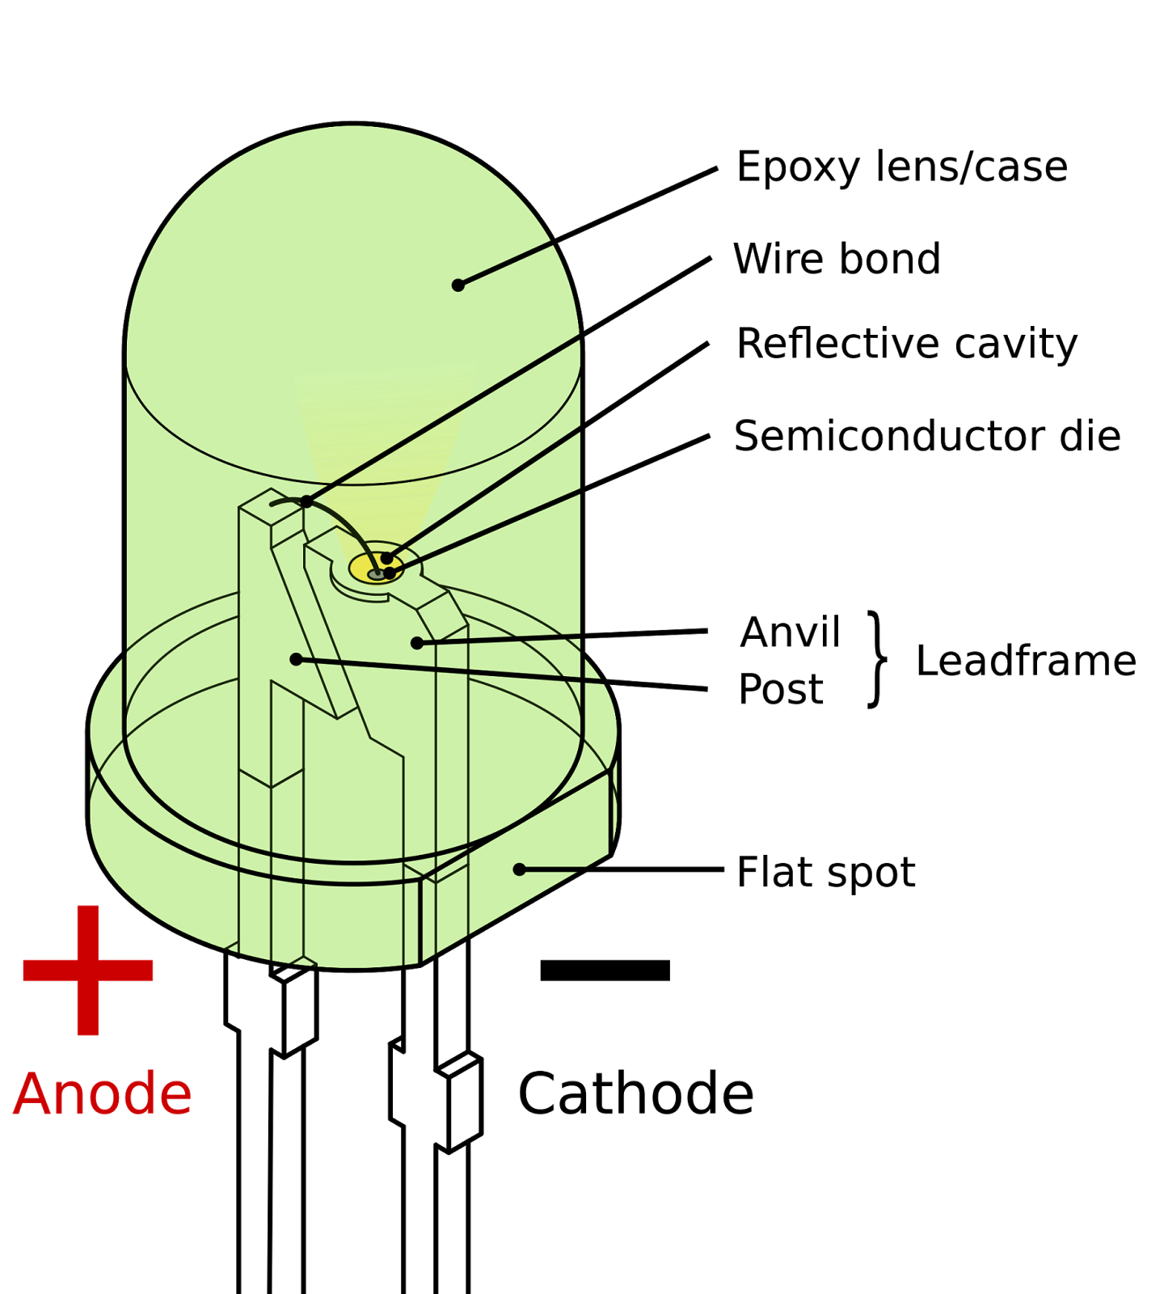
LED light mechanics

Slide 9
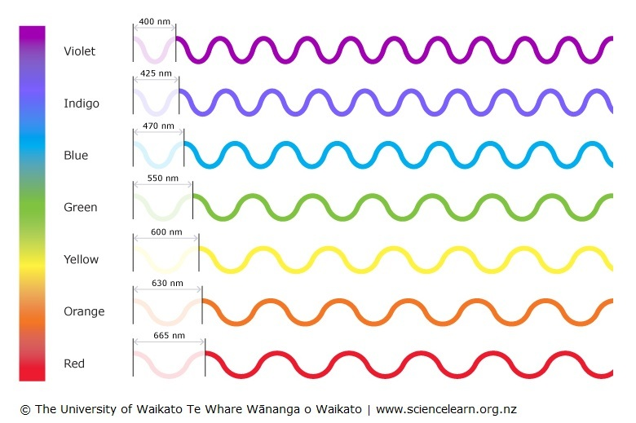

Slide 10
conclusion

Slide 11
Works Cited
Colours of light. (2012, April 4). Retrieved May 22, 2020, from Science Learning Hub: https://www.sciencelearn.org.nz/resources/47-colours-of-light
Cook, M. (2018, April 11). Different Kinds of Bread Mold. Retrieved May 24, 2020, from Sciencing: https://sciencing.com/different-kinds-bread-mold-5956459.html
Does Mold Grow Faster in the Light or Dark? (2017, July 21). Retrieved May 24, 2020, from Sciencing: https://sciencing.com/does-mold-grow-faster-in-the-light-or-dark-13420833.html
Dover, L. (n.d.). Retrieved May 22, 2020, from Star Light, Star Bright: https://history.amazingspace.org/resources/explorations/light/star-light-author.html
HOW FUNGI ARE CONSTRUCTED. (n.d.). Retrieved May 24, 2020, from http://website.nbm-mnb.ca/mycologywebpages/NaturalHistoryOfFungi/Thallus.html
HOW FUNGI ARE CONSTRUCTED. (n.d.). Retrieved May 24, 2020, from http://website.nbm-mnb.ca/mycologywebpages/NaturalHistoryOfFungi/Thallus.html#Yeasts
How Mold Grows and More: Your Mold Questions Answered. (n.d.). Retrieved May 24, 2020, from Wet & Forget: https://www.wetandforget.com/blog/2018/06/27/how-mold-grows/
Learn About LED Lighting. (n.d.). Retrieved May 21, 2020, from Energy Star: https://www.energystar.gov/products/lighting_fans/light_bulbs/learn_about_led_bulbs
Mold. (n.d.). Retrieved May 22, 2020, from Science Daily: https://www.sciencedaily.com/terms/mold.htm
MOULDS AND THEIR CHARACTERISTICS. (n.d.). Retrieved May 24, 2020, from http://website.nbm-mnb.ca/mycologywebpages/Moulds/Characteristics.html
PhilipsHorticulture. (2013, January 31). The effect of light on plant growth. Retrieved May 21, 2020, from Youtube: https://www.youtube.com/watch?v=FaeDcO3Pk8g
Student Reading: Thermal Energy from Light. (2017, October 31). Retrieved May 22, 2020, from InTeGrate: https://serc.carleton.edu/integrate/teaching_materials/energy_sustain/student_materials/thermal_energy_.html#:~:text=The%20energy%20associated%20with%20a,at%20shorter%20wavelengths%20(ultraviolet).

