Slide 1
Napoleon Bonaparte the Colossus of the Nineteenth Century
SS9 Final Project: Shamus, Callum, A.J, Cassidy

Slide 2
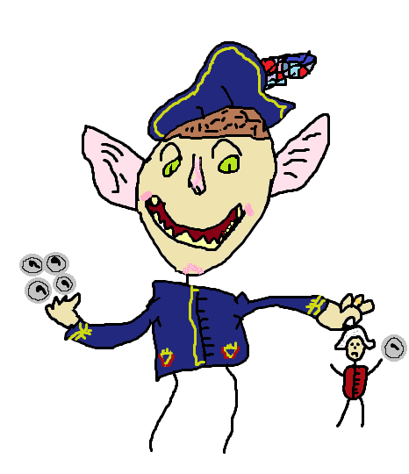
Napoleon’s start as a general Shamus
One of the first attacks Napoleon led was in Italy. The Italians wanted to rule by themselves and did not like the way the Austrians treated them. Napoleon then promised in 1797 to give the Italians what they wanted. Napoleon was victorious, and as payment, he ordered his army to seize any valuables they found. This plan worked according to plan, and it paid for his army and made him rich. However, he had his great moments, he also had his lows, and at this time, he was a bit arrogant, to say the least. His next target after his Italy raid was Egypt since his main goal was to defeat Britain, and they were trading with India through Egyptian rivers. He was very successful against the Egyptian army; however, the British army destroyed his mere days after.
Question: How did Napoleon gain his power at first?
Answer: In 1795, Napoleon rescued the Convention from a rebellious mob of French citizens. The government rewarded him for this action with control of the French army in Italy. After that, he started to lead attacks.

Slide 3
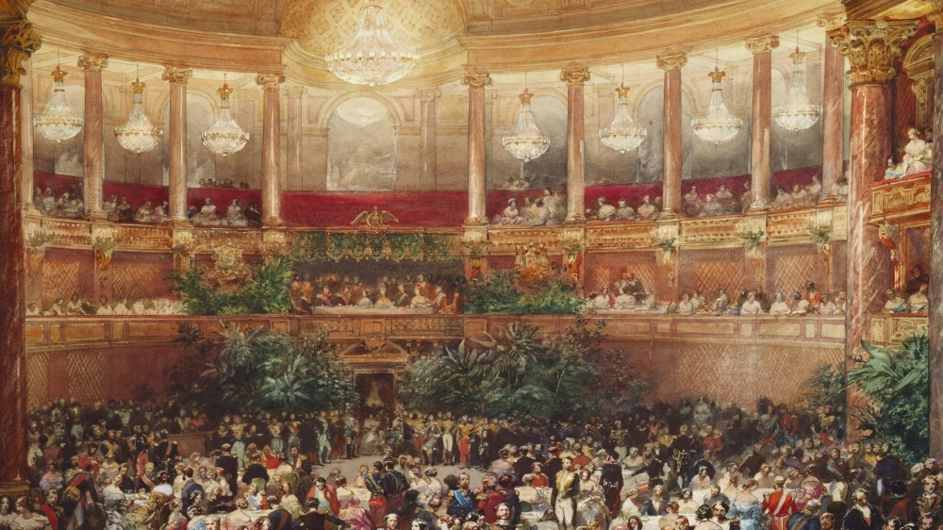
Napoleon’s Living Conditions
Napoleon was an emperor; however, he did not live like a traditional king or dictator. This was due to his significant position as a general in the French army. Napoleon spent the vast majority of his life travelling with his army fighting in battles and campaigns. However, of course, he did have one main property, which was the "Palace of Versailles," which had been build up by Louis XIV. He was given that place to live, but he lived only in places close to there while not on campaigns. His alternatives were the "Tuileries Palace"; however, he also lived at the "Grand Trianon," which was the closest thing to Versailles.
Question: Who was his family during his reign?
Answer: After Napoleon took command of the French army in 1795, he met "Josephine de Beauharnais." They got married in March of the next year. She was Napoleon's first wife until they divorced in 1809. Napoleon married Marie Louise a few months after his divorce in 1810, which resulted in an heir that Josephine could not give him. The child was named Napoleon the 2nd and was born on March 20, 1811.
Palace of Versailles

Slide 4
Military experience Callum
Napoleon attended military school at age fifteen when Rochet Louis handed him documents proving nobility. Throughout his school journey Napoleon managed to become an artillery officer through his school. What would an artillery officer do during there career you may ask? Well, an artillery officer would manage the weapons that are being fired at the enemy. He was not a remarkable student at school but read on his own to further improver his knowledge. He had a phenomenal memory and had a head for detail.
Question: What would an artillery officer do?
Answer: An artillery officer would manage the weapons that are being fired at the enemy.

Slide 5
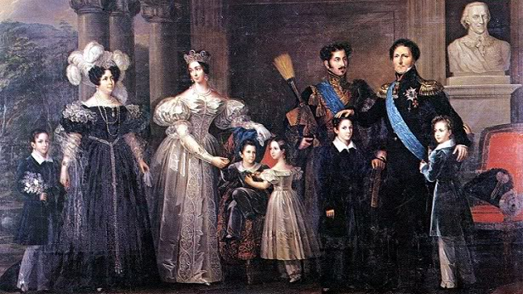
The Bonaparte family
Napoleon or Louis Napoleon Bonaparte was born into a family that was part of a minor nobility which means his family was not upper-class but more of a minor upperclassman. The minor nobility consists of lower status noblemen, often not more than Troopers or Ministerialist (characteristics of a minister (minister member of the clergy) of religion) or member of the clergy. His family had strong ties, but they were poor, yet the family still supports each other. Napoleon’s mother was name was Letizia Ramolino and his father was named Carlo Buonaparte. He died when Napoleon was six-teen which meant that napoleon was head of his family at such a young age.
Question: What was Napoleons full name and what was a ministerialist?
Answer: His full name was ”Louis Napoleon Bonaparte” and a ministerialist was characteristics of a minister, and a minister was a member of the clergy.

Slide 6
Changes brought by napoleon A.j
Question: Why did Napoleon want to use plebiscite to appear democratic?
Answer: Most of the French population was pro-democrat so he had to do something to get the votes for what he wanted.
Some of the changes Napoleon made were good changes. For example, he lowered food prices, he made peace between the state and Catholic Church. When the vote came Napoleon used plebiscites (the direct vote of all the members of an electorate) to appear democratic but then he changed the results to get what he wanted. He also filled the museums up with art and treasures that were often stolen. Napoleon also implemented a gold coin as new currency called the Napoleon.

Slide 7
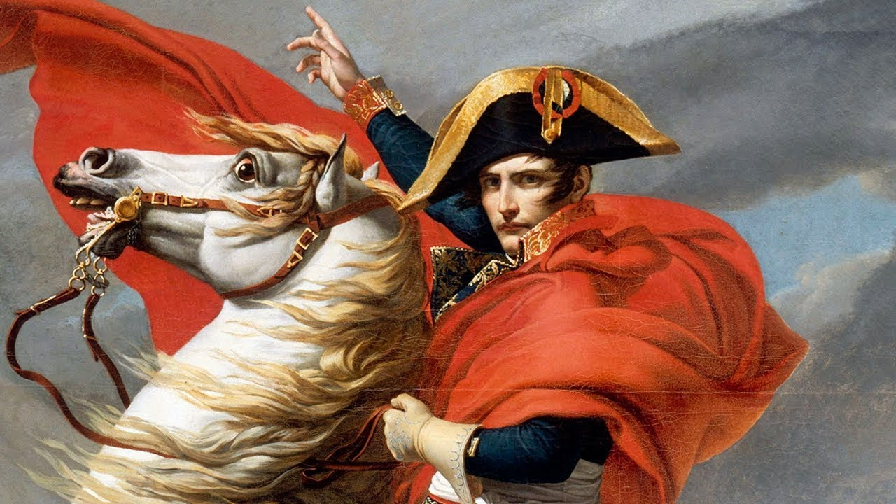
How Napoleon affected others outside of France
The influence of the civil code was adopted by countries under French rule. (Italy, Poland, Belgium, Spain, Portugal, Romania.) The civil code of lower Canada was revised to include the Napoleonic code. Haitians hoped the Declaration of Rights of Man and the Citizen would ensue their equality and outlaw slavery. Napoleon made a promise to help the slaves if they supported him in the takeover of Britain. The slave revolted which caused Britain to withdraw and declared the Haiti where independent. Napoleon then sent warships to take over the island and he passed a law supporting slavery.
Question: How did Napoleonic code impact over countries outside of France.
Answer: The Napoleonic code was implanted into the countries that had been taken over by France. The civil code of lower Canada was also revised to include the Napoleonic code since New France had followed the French laws.

Slide 8
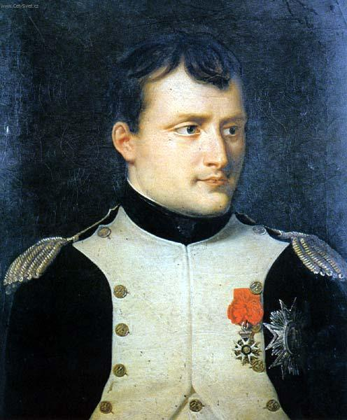
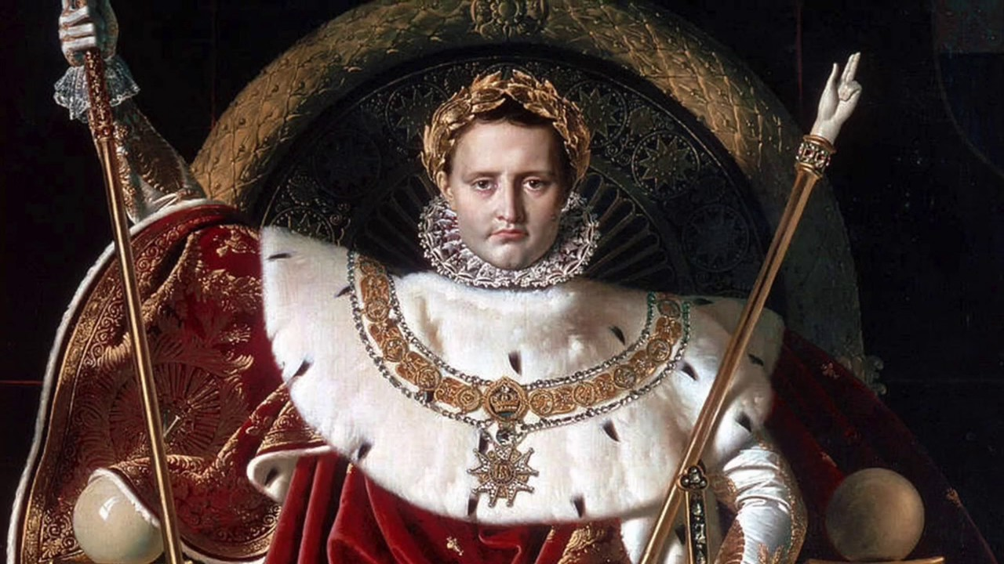
Napoleon’s life summary Cassidy
Napoleon was born on the island of Corsica, He grew up in a minor nobility family, He attended military school and his father died when he was 16, He also knew Italian since the island of Corsica was part of Italy at the time, His family ties were very strong with his mother playing a very big role in his life and helping him with financial troubles since he was poor at the time.
Question: When did Napoleon’s father die?
Answer: 24th of February 1785.
After Napoleon saved the Convention from a rebellious mob of French citizens, he was rewarded with command of the French army which was the beginning of his success. He then went to drive out the Austrians and set up French controlled republics in Italy. He then went and dominated the Egyptian army, before getting absolutely obliterated by Britain days later.
Question: How long did the Napoleon Era last?
Answer: 16 Years.

Slide 9
Citations
Picture links
https://www.sfcv.org/sites/default/files/styles/reduced_size/public/u49590/Paintingheader2.jpg?itok=ooDpUTWd
-https://h-france.net/fffh/wp-content/uploads/2014/12/Desiree7.jpg
-https://i.ytimg.com/vi/6byPTxYYUkg/maxresdefault.jpg
-https://i.ytimg.com/vi/KkSMmxObjTk/maxresdefault.jpg
-https://3.bp.blogspot.com/-FBo-TTTj3TY/UOfDpFXnzGI/AAAAAAAAAQY/XlC4QsL1l9g/s1600/napoleon-bonaparte.jpg
All group members used the Napoleon notes in Microsoft teams
Shamus
-“Napoleon Bonaparte: the Rise and Fall of a Dictator.” HistoryExtra, 14 Aug. 2019, https://www.historyextra.com/period/georgian/napoleon-bonaparte-emperor-france-rise-fall-dictator/
-“Napoleon Bonaparte Biography.” Encyclopedia of World Biography, 2008, www.notablebiographies.com/Mo-Ni/Napoleon-Bonaparte.html.
-Delacour, Jeanne, and Iqrash Ahmed. “Where Did Napoleon Live When He Was Emperor?” Quora, 10 Oct. 2017, www.quora.com/Where-did-Napoleon-live-when-he-was-emperor.

Slide 10
Credits
Shamus-
Question making, PowerPoint creator
Callum-
Overall Game making, Creative mind
A.J-
Designer of game, Technical expert
Cassidy-
Game surveyor, Information gatherer

